Slide 1
Day 1
Embedded Systems & Embedded C Basics

Slide 2
What is an Embedded System?
Dedicated system for a specific task
Works automatically without user interaction
Responds in real time
Example:
Washing machine selecting wash mode automatically
Air conditioner controlling temperature

Slide 3
Embedded Systems in Daily Life
Mobile phones
Traffic signal controllers
Medical monitoring devices
Smart TVs
Smart watches

Slide 4
Why Programming is Needed
To control hardware behavior
To make decisions automatically
Example:
If temperature > 40°C → Turn ON fan
If door is open → Stop motor

Slide 5
Why Normal C is Not Enough?
C works on computers
No direct hardware control
Example:
C → Print “LED ON” on screen
Embedded C → Actually turn ON LED

Slide 6
What is Embedded C ?
C language used for embedded systems
Direct control of hardware
Example:
Embedded C program to blink LED
Embedded C program to read temperature sensor

Slide 7
Features of Embedded C
Hardware access → LED, Motor, Relay
Timing control → Traffic signal timing
Interrupt handling → Doorbell press

Slide 8
C vs Embedded C
C Language | Embedded C
Text output | Physical output
Software programs | Hardware control
Desktop apps | Embedded devices

Slide 9
What is a Microcontroller?
Single-chip embedded computer
Controls entire system
Example:
Microcontroller inside washing machine
Microcontroller inside microwave oven

Slide 10
Role of Embedded C in Microcontroller
Reads sensor values
Makes decisions
Controls outputs
Example Flow:
Temperature sensor → MCU → Embedded C → Fan ON

Slide 11
Components of a Microcontroller
Central Processing Unit (CPU)
RAM
ROM / Flash memory
I/O ports
Timers and counters
Communication interfaces

Slide 12
8051 Microcontroller
Overview of 8051 Microcontroller
8-bit microcontroller developed by Intel
Simple and easy architecture
Low processing speed
Widely used for learning embedded systems
Features of 8051
8-bit CPU
On-chip RAM and ROM
Multiple I/O ports
Timers and serial communication
Low power consumption
Applications of 8051
Traffic signal control
Small automation systems
Educational projects

Slide 13
AVR Microcontroller
Overview of AVR Microcontroller
8-bit microcontroller with RISC architecture
Higher performance compared to 8051
Efficient instruction execution
Commonly used in Arduino platforms
Features of AVR
RISC-based architecture
High-speed execution
On-chip ADC
Low power modes
Rich peripheral support
Applications of AVR
Arduino-based IoT systems
Robotics and automation
Sensor-based projects
Consumer electronics

Slide 14
ARM Microcontroller
Overview of ARM Microcontroller
32-bit microcontroller architecture
High performance and scalability
Used in commercial and industrial systems
Supports advanced operating systems
Features of ARM
32-bit CPU
High clock speed
Large memory support
Advanced communication interfaces
RTOS support
Applications of ARM
Smartphones and tablets
Medical devices
Automotive
Electronics Industrial automation

Slide 15
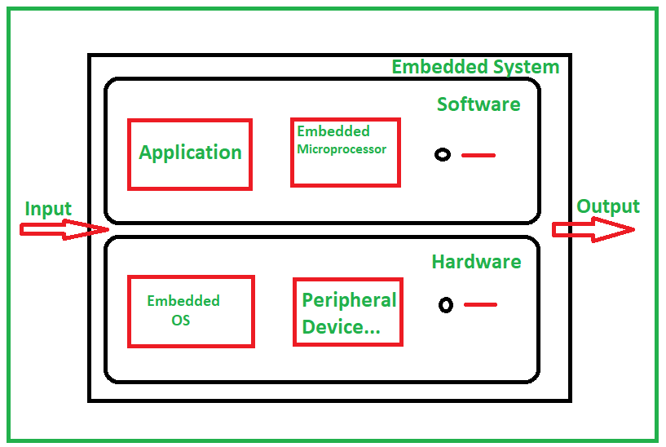
Embedded System Architecture

Slide 16
Embedded System Architecture
Example: Automatic Street Light
Input: LDR sensor
Processing: Microcontroller
Output: Street light ON/OFF

Slide 17
Input Units
Temperature sensor → AC control
IR sensor → Automatic door
Ultrasonic sensor → Parking system

Slide 18
Output Units
LED → Status indication
Motor → Washing machine drum
Buzzer → Alarm system
Display → ATM screen

Slide 19
Timers in Embedded C
Used for accurate timing
Examples:
Traffic signal delay
Washing machine wash time
LED blinking every 1 second

Slide 20
Interrupts in Embedded C
High-priority events
Examples:
Doorbell press
Emergency stop button
Fire alarm signal

Slide 21
LED BLINK PROGRAM IN ARDUINO
#include <Arduino.h> // Header file
void setup() {
pinMode(13, OUTPUT); // Set pin 13 as output
}
void loop() {
digitalWrite(13, HIGH); // LED ON
delay(1000); // 1 second delay
digitalWrite(13, LOW); // LED OFF
delay(1000); // 1 second delay
}

Slide 22
Thank You

